Slide 1

Spanish experience with intestinal (Itx) and multivisceral transplantation (MVtx) in adults
Experiencia española con un programa de Trasplante Intestinal y Multivisceral en adultos
J. Calvo (University Hosp. 12 de Octubre, Madrid, Spain)
jcalvopulido@yahoo.es
Tfno y Fax: +34913908077

Slide 2
PATIENTS AND METHODS
Between December 2004 and December 2012
53 patients evaluated
Most of them not eligible

Slide 3
PATIENTS AND METHODS (II)

Slide 4
PATIENTS AND METHODS (III)

Slide 5
PATIENTS AND METHODS (IV)
We have performed 21 intestinal transplants in 19 patients.
17 were isolated intestinal (IT) and 4 multivisceral (MVT).

Slide 6
RESULTS
Short bowel syndrome was found in 63 % (12/19) of the patients.
79% under HPN (15/19 patients).
Mean = 27 ± 40 months HPN preItx
86 % (13/15 patients) had HPN related complications.

Slide 7
RESULTS (I)
HPN COMPLICATIONS
Thrombosis: 33,3% (7); SVC: 9,5%
CRI: 38% (8); x= 0,6 ± 0,8 episodes/year
Non CRI: 43% (9); x= 1,3 ± 1,5 replacements
Metabolic: 62% (13); PNLD: 43% (9)
Intestinal Obstruction: 19% (4)

Slide 8
RESULTS (II)
IF in Transplanted Patients
21/19
FAP-DT | 33,3% (7 patients)
Vascular | 19% (4 patients)
Crohn´s Disease | 4,8% (1 patient)
Miscelanous Trauma Retransplant GIST Schistosomiasis Polycitemia Vera Bariatric Surgery Complications | 43% (9 patients) 9,5% (2 patients) 14,3% (3 patients) 4,8% (1 patient) 4,8 (1 patient) 4,8% (1 patient) 4,8% (1 patient)

Slide 9
RESULTS (III)

Slide 10
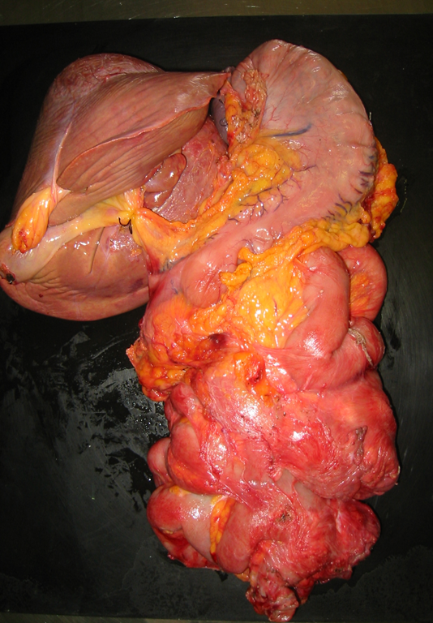
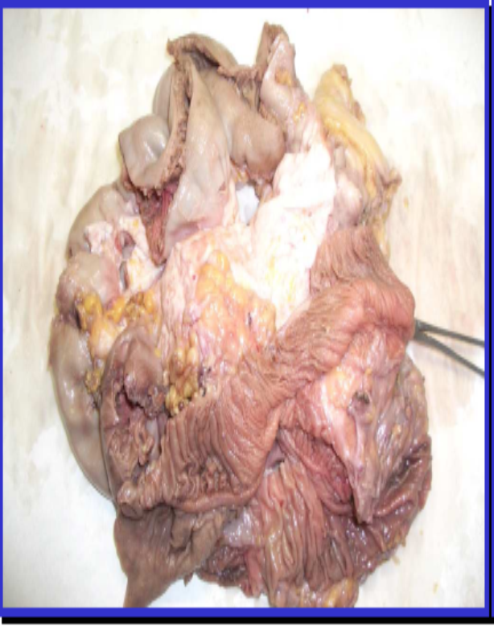

Slide 11
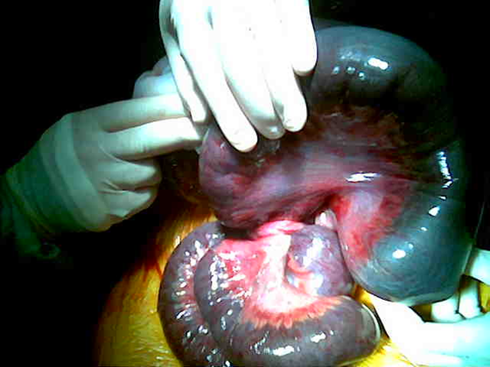

Slide 12
RESULTS (IV)
Intraoperative Complications
Medical Complications
Surgical Complications
Immune Complications (Rejection)
PTLD

Slide 13
RESULTS (V)
Introperative Complications
Medical Complications
Surgical Complications
Immune Complications (Rejection)
PTLD

Slide 14
RESULTS (VI)

Slide 15
RESULTS (VII)
Intraoperative Complications
Medical Complications
Surgical Complications
Immune Complications (Rejection)
PTLD

Slide 16
RESULTS (VIII)

Slide 17
RESULTS (IX)
INFECTIONS (I)
General Incidence: 5,1 episodes/1000 transplant days
Bacterial Infections: 3,38/1000 transplant days
Viral Infections: 1,22/1000 transplant days (0,81 due to CMV)
Fungal Infections: 0,54/1000 transplant days

Slide 18
RESULTS (X)
INFECTIONS (II)

Slide 19
RESULTS (XI)
METABOLIC COMPLICATIONS

Slide 20
RESULTS (XII)
RENAL FAILURE
68,4 % (13/19 Itx) had RF/Impaired Renal function
15,6% of all medical complications
Multifactorial
Dyalisis in 3 patients in the early PO period
One patient awaiting Kidney Transplantation
Loop Ileostomy Closure done in 5 of 12 living patients.
Improved Renal Function (3/5) and avoided progression in other 2.
7 still with Ileostomy: 1 KTx, 4 RF +/- N and 2 PTCRF.

Slide 21
RESULTS (XIII)
Intraoperative Complications
Medical Complications
Surgical Complications
Immune Complications (Rejection)
PTLD

Slide 22
RESULTS (XIV)
SURGICAL COMPLICATIONS Itx | (%/number)
Mesh Infection | 37% (13)
Intraabdominal Fluid Collections | 11,4% (4)
Haemoperitoneum | 14,2% (5)
Intestinal Leak/Perforation | 11,4% (4)
Pancreatitis | 5,7% (2)
Urinary Fistula | 5,7% (2)
Haematoma | 2,8% (1)
Gallbladder Perforation | 2,8% (1)
Arterial Graft Mycotic Pseudoaneurism | 2,8% (1)
Desmoid Recurrence | 5,7% (2)

Slide 23
RESULTS (XV)
REOPERATIONS in Itx | (%/number)
Mesh Removal | 33,3% (19)
Intestinal Perforation/Leak | 12,2% (7)
Explant | 8,7% (5)
Haemoperitoneum | 12,2% (7)
Intraabdominal Collections Drainage | 7% (4)
Tracheostomy | 7% (4)
Ileostomy Closure | 10,5% (6)
Mucormicosis | 1,7% (1)
Pancreatitis | 1,7% (1)
Bowell Obstruction | 1,7% (1)
Mycotic Pseudoaneurism | 1,7% (1)
Desmoid Recurrence Resection | 1,7% (1)

Slide 24
RESULTS (XVI)
5/21 explanted grafts (23,8%)
7/21 grafts loss (33%)

Slide 25
RESULTS (XVII)
Intraoperative Complications
Medical Complications
Surgical Complications
Immune Complications (Rejection)
PTLD

Slide 26
RESULTS (XVIII)
Induction: Alemtuzumab (anti-CD 52)
Manteinance IS: TAC
14/21 grafts AR (66,6 %); Total: 145 rejection diagnosed (IR)
22 rejection episodes in patients who suffered it
x=1,1 ± 0,9 episodes/patient (0-3); 50% > 2 episodes
64,2% before 3 months (AR < 90 days);
x=28 ± 25 days (1-81)
IR: 51% (74); AR-I: 20% (29); AR-II: 16 % (23); AR-III: 11,7% (17)

Slide 27
RESULTS (XIX)
71% mild episodes of AR (IR/AR)
27,5% moderate-severe AR (17,6% de Refractory Rejection)

Slide 28
RESULTS (XX)
Intraoperative Complications
Medical Complications
Surgical Complications
Immune Complications
PTLD

Slide 29
RESULTS (XXI)
2 PTLD (B-cell Lymphomas) (10,5%)
8 PTLD in 7 patients (36,8%)
Six PH reactive/policlonal + 2 Lymph.
62,5% CR (in 3 was found in resected specimen and intestinal biopsies)
One skin cancer (Melanoma)

Slide 30
RESULTS (XXII)
21 Itx in 19 patients.
12 patients alive and 7 died
Living Patients have complete HPN Independence
All resumed daily activities (jobs, studies…)
Overall Survival: 63%; Overall Mortality: 37%
Patients Follow up: 35,3 ± 30 months (1-94)
Grafts Follow up: 32,7 ± 32 months (0-94)

Slide 31
RESULTS (XXIII)
Mean Patient Survival:
61,7 ± 9,6 months (42,8-80,5)
Patients Actuarial Survival at 1, 3, 5 and 7 years: 85%; 66,3%; 58% and 58% respectively
Mean Graft Survival:
59,3 ± 9,6 months (40,5-78)
Grafts Actuarial Survival at 1, 3, 5 and 7 years: 71,4%; 65,5%; 57,3% and 57,3% respectively

Slide 32
RESULTS (XXIV)
MORTALITY | POSTRANSPLANT TIME (months)
PTLD Ischemic Enteritis | 13 months
AR-III + PH + CMV Infection | 12,5 months
AR-III + PH + CMV Infection + CR | 22 months
Severe Acute Pancreatitis –MOF (MV tx) | 1,2 months
MOF-Invasive Aspergillosis | 2,5 months
MOF-Bronchoaspiration | 6 months
Massive Brain Hemorrage (Severe Thrombopenia) | 41 months

Slide 33
CONCLUSIONS
These preliminary results appear encouraging.
All surviving patients are TPN free.
Patient and graft survival results are comparable to high volume and experienced centers.
Careful patients selection must be done.

